Slide 1


5011CEM Big Data Programming Project
<Quah Zhi Chao>

Slide 2
Presentation Agenda
Flow of the presentation:
Parallel & Sequential Processing
Data Analysis - Objective - Dataset Explanation - Findings & Discussion
Conclusion
References

Slide 3
Parallel & Sequential Processing
Sequential Processing:
Processing that occurs in the order that it is received
Parallel Processing:
Two or more processors are used to process concurrently (in parallel)

Slide 4
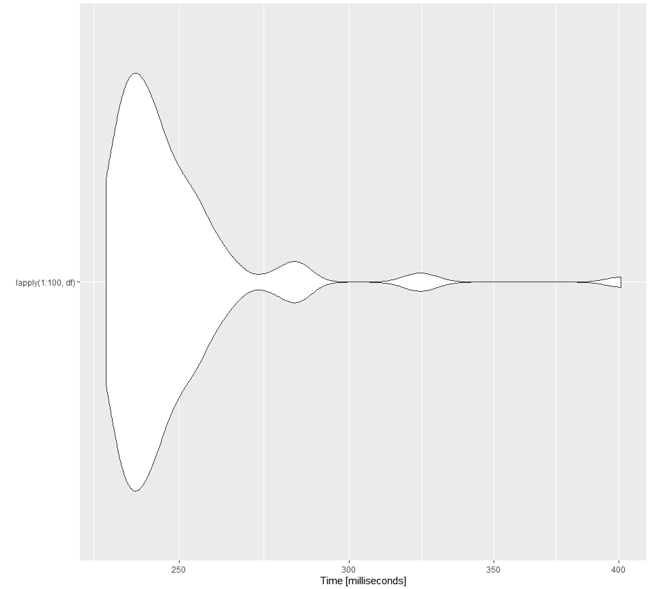
Parallel & Sequential Processing
R Studio Code Result and Visualization for Sequential:
begin microbenchingmarking
Start
lapply(1:100,df)
visualize values
plot value
print
value
Stop

Slide 5
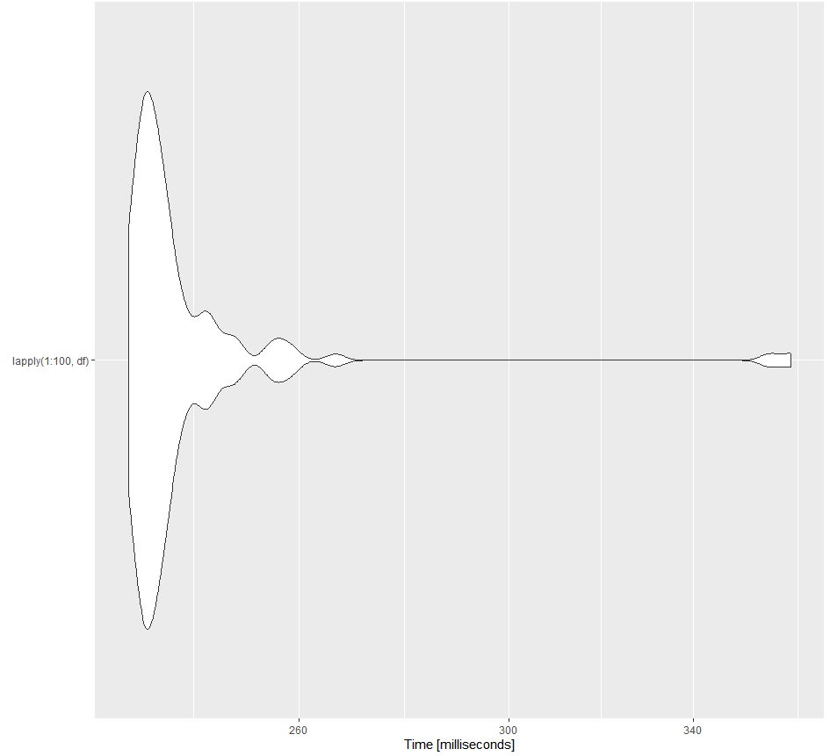
Parallel & Sequential Processing
R Studio Code Result and Visualization for Parallel:
begin microbenchingmarking
Start
parallel
Processing
visualize values
plot value
print
value
Stop

Slide 6

Data Analysis
Objective: Find the relationship between the age between the comsumer and number of transaction in Grocery Purchases in Borough-Level Areas.
Dataset and Attributes Used:
Data from year_borough_grocery.csv

Slide 7
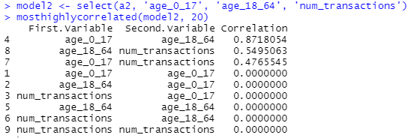
Data Analysis – Findings & Discussions
Correlation between the numerical data:

Slide 8
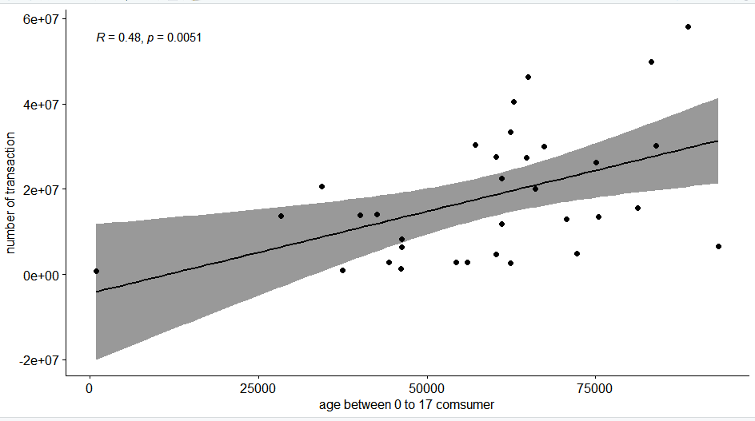

Data Analysis – Findings & Discussions
Correlation Visualization:

Slide 9
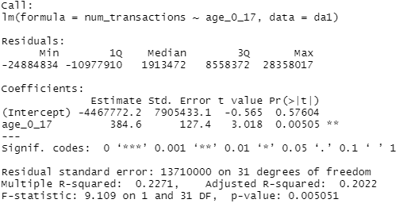
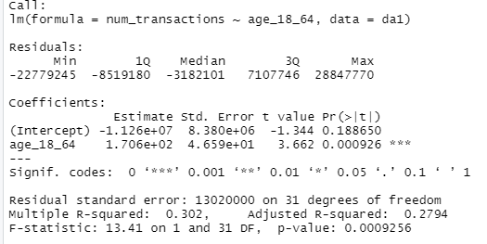
Data Analysis – Findings & Discussions
Hypothesis Testing Results: 5% Level of Significance
age_0_17 & num_transactions
(p-value: 0.005051)
age_18_64 & num_transactions
(p-value: 0.0009256)

Slide 10
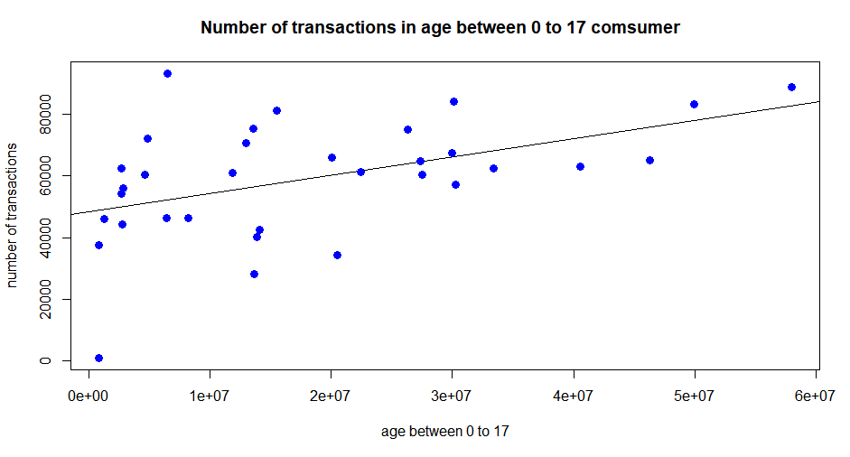
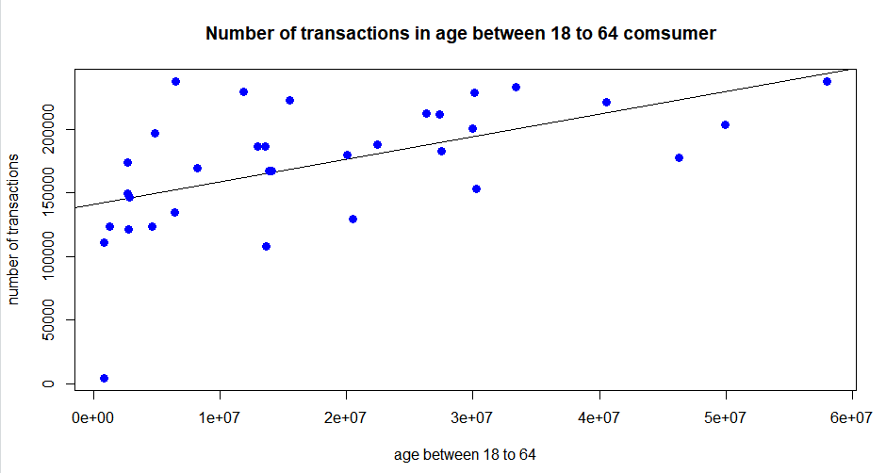
Data Analysis – Findings & Discussions
Regression Analysis Results:

Slide 11
Conclusion
From these regression analysis code outputs for these 2 age groups as (x-axis independent variables) and number of transactions as (y- axis dependent variable), we can visualize that {age_18_64} and {volume} has the highest correlation followed by those of {age_0_17} with {number of transactions}.

Slide 12
References
1.) Aiello, L.M., Quercia, D., Schifanella, R. and Del Prete, L. (2020). Tesco Grocery 1.0, a large-scale dataset of grocery purchases in London. Scientific Data, [online] 7(1). doi:10.1038/s41597-020-0397-7. [Accessed 19 Nov. 2022].
2.) GeeksforGeeks. (2022). Difference between Sequential and Parallel Computing. [online] Available at: https://www.geeksforgeeks.org/difference-between-sequential-and-parallel-computing/. [Accessed 19 Nov. 2022].

Slide 13
THANK YOU

